Slide 1


5005CEM Lecture 1b: Introduction to Data Science
School of Computing, Mathematics and Data Science Coventry University
5005CEM Data Science 2022/23 Semester 2

Slide 2
What is Data Science?
A process of using data to understand things.
Data tell a story.
Uncover insights, patterns and trends.
Transforming data into knowledge that can guide decisions.
Science (apply the scientific method).
Observe some phenomenon and record observations (data).
Explore, formulate hypotheses, build models, make predictions.
Design experiments to confirm.
Notes:
Further reading: https://towardsdatascience.com/explaining-data-science-ai-ml-and-deep-learning-to-management-a-presentation-and-a-script-4968491eb1e5

Slide 3
What is Data Science?
The sum of its parts.
Artificial intelligence
Machine learning
Mathematics and statistics
Data analytics
Data engineering (extract, transform, load, clean)
Data visualisation
Algorithms and infrastructure
Data storage/retrieval
Domain/business knowledge

Slide 4
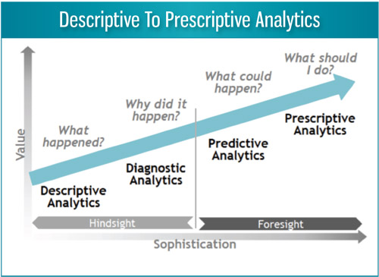
What is Data Science?
Analytics is “the scientific process of transforming data into insights for the purpose of making better decisions.” — INFORMS
Notes:
Image from: https://facilityexecutive.com/2016/06/predictive-analytics-for-low-tech-facilities/
Quote from: https://www.informs.org/About-INFORMS/News-Room/O.R.-and-Analytics-in-the-News/Best-definition-of-analytics

Slide 5
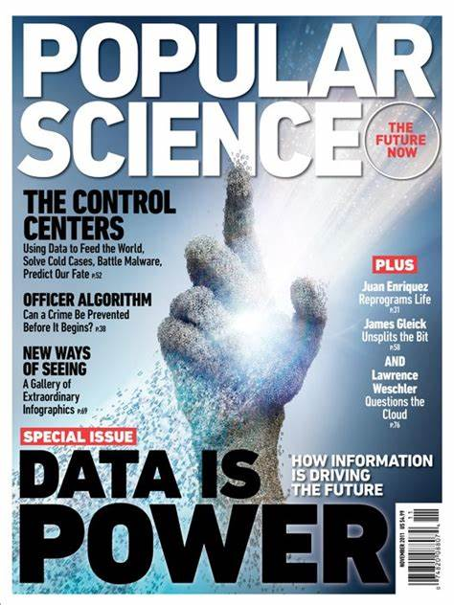
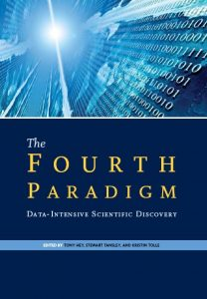
Paradigms of Science
Experimental/empirical science (describing natural phenomena) — last 2500 years
Theoretical science (using models, generalisations) — last few centuries
Computational science (simulating complex phenomena) — last few decades
Data-intensive science (unify theory, experiment, simulation) — last few years
Notes:
Image from:

Slide 6
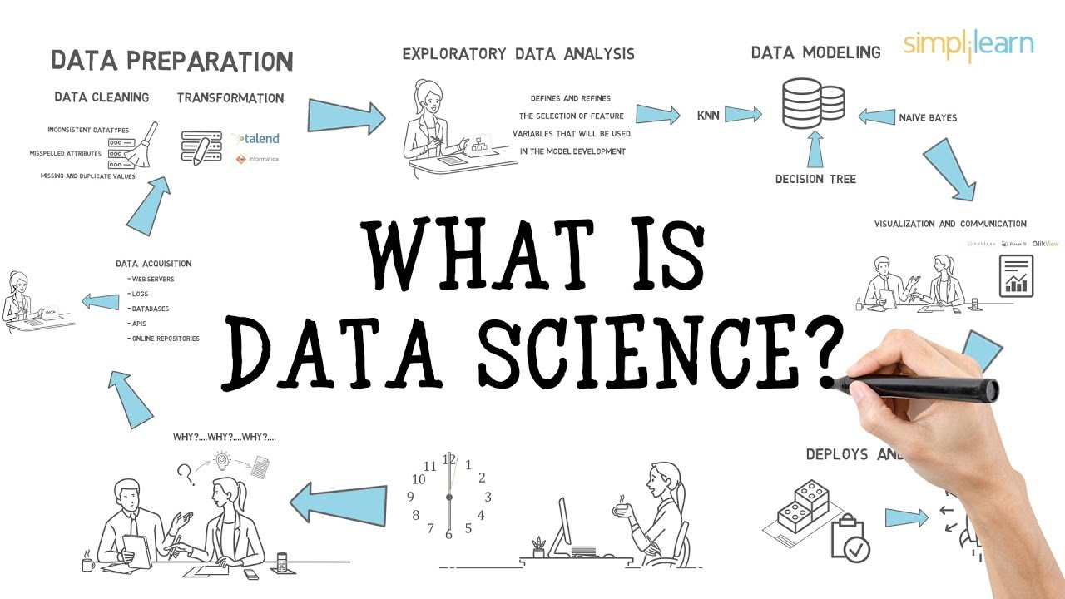
What is Data Science?
Notes:
Image: https://i.ytimg.com/vi/X3paOmcrTjQ/maxresdefault.jpg
Youtube: https://www.youtube.com/watch?v=X3paOmcrTjQ

Slide 7
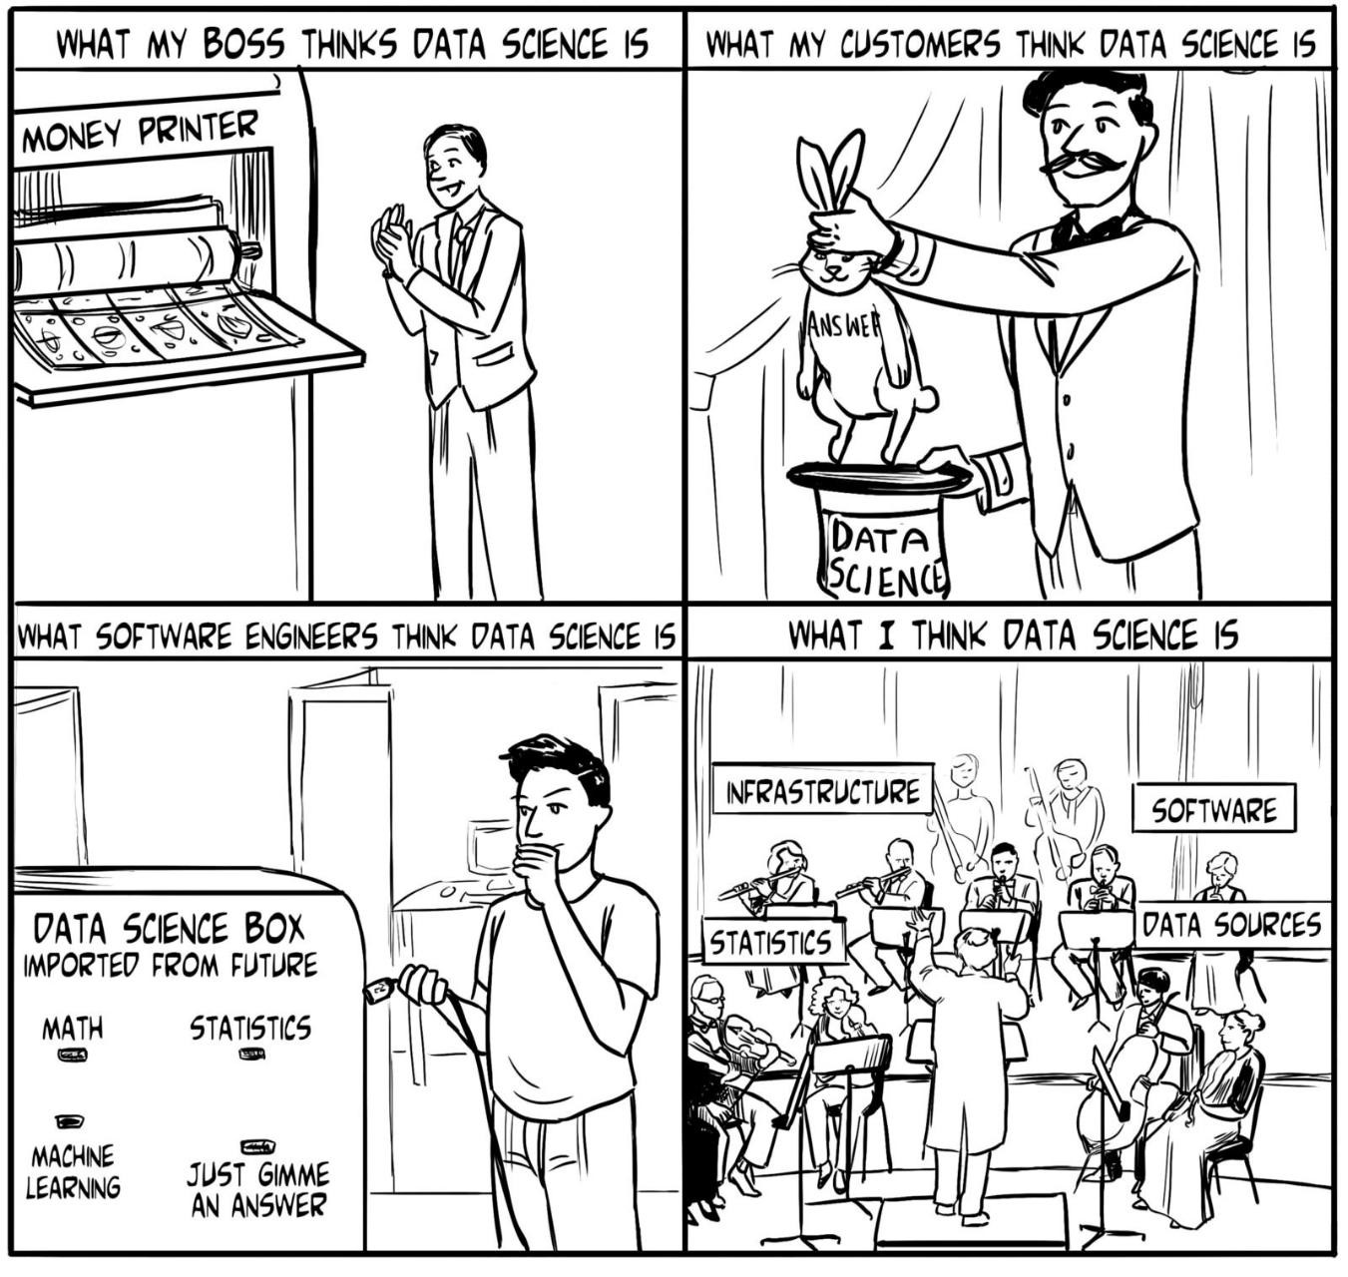
Notes:
Image from: https://towardsdatascience.com/explaining-data-science-ai-ml-and-deep-learning-to-management-a-presentation-and-a-script-4968491eb1e5

Slide 8
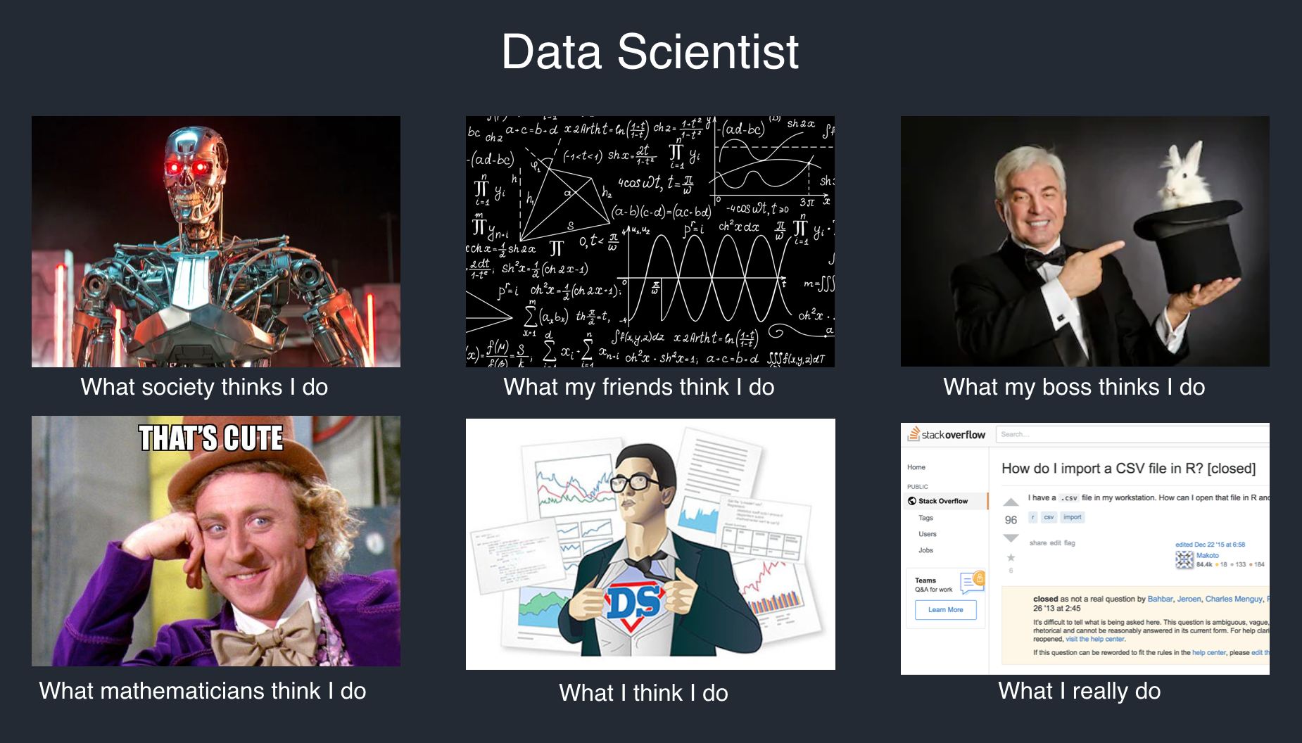
Notes:
Image from: https://towardsdatascience.com/tips-on-defining-a-data-science-project-scope-with-business-baa5a5b652b7

Slide 9

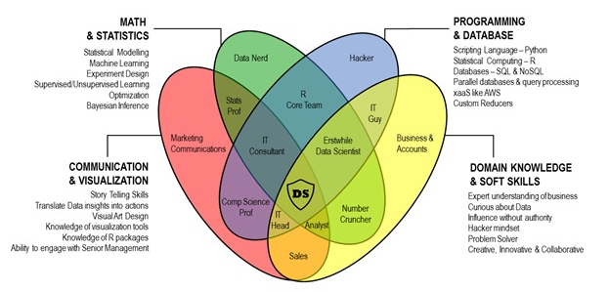
Data Scientist’s superpowers
Notes:
Image from: https://www.inspiringmeme.com/why-data-scientist-is-the-sexiest-job-in-the-21st-century/

Slide 10
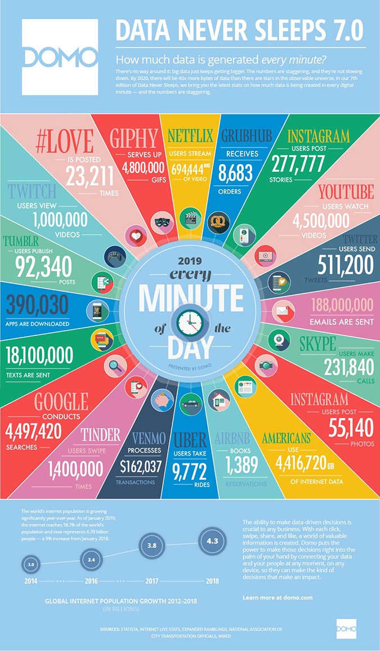
Data never sleeps
Notes:
Image from: https://www.domo.com/learn/data-never-sleeps-7

Slide 11

How much data is out there?
Estimated that there is approximately 40 zettabytes of data in the world (2019)
1 zettabyte = 10^21 bytes = 1 trillion gigabytes
Notes:
Data from: https://www.visualcapitalist.com/how-much-data-is-generated-each-day/
Image from: https://quantumfbi.com/big-data-trends-financial-services/

Slide 12

Some Data Science Applications
“Data is the new oil” — Clive Humby (2006)
Customer profiling (loyalty cards, fraud detection)
Recommender systems (Netflix, Amazon)
Internet search engines (Google)
Targeted advertising (Facebook)
Credit scoring
Healthcare (medical image analysis, genomics)
Sport (Moneyball – book 2003, film 2011)

Slide 13
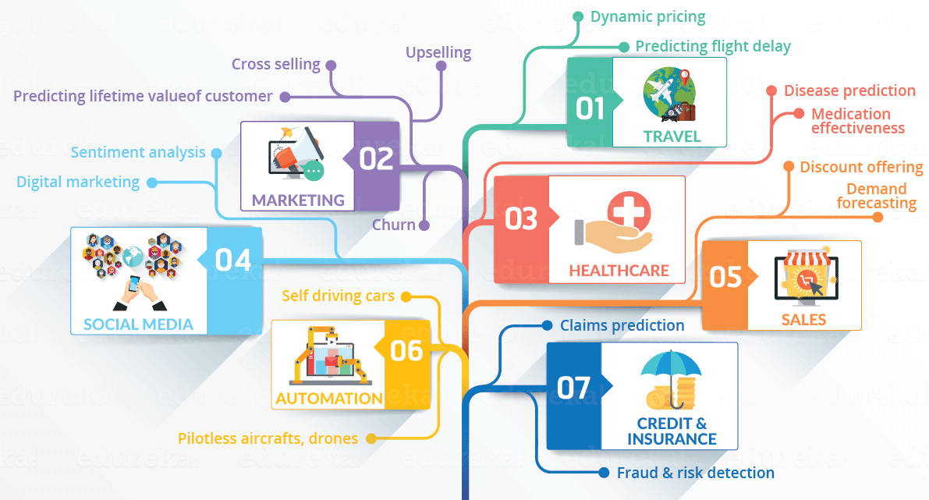
Some Data Science Applications
Notes:
Image from: https://www.edureka.co/blog/what-is-data-science/

Slide 14
Summary
Data Science is applying scientific methods to extract knowledge and insights from data.
Descriptive/diagnostic/predictive/prescriptive analytics.
Data Science involves a wide range of skills and knowledge.
“Data never sleeps” (always being generated).

